Slide 1
ONLINE RETAIL STORE
Presented by GHANSHYAM SINGH SHAKTAWAT
Capstone Project 04

Slide 2
Page 02
OVERVIEW
Introduction
K-Means Clustering
Objective
Methodology
Visualisation
Feature Engineering
Conclusion
Thank You

Slide 3
Page 03
Introduction
In this project, we aim to analyze a transnational dataset capturing transactions from 01/12/2010 to 09/12/2011 for a UK-based online retail store specializing in unique all-occasion gifts. Focusing on customer segmentation, the goal is to identify major segments, particularly recognizing the distinctive characteristics of wholesale customers. This analysis will contribute valuable insights for tailored marketing strategies, inventory optimization, and overall business enhancement in the dynamic landscape of online retail.

Slide 4
Page 04
K-Means Clustering
K-means clustering is a machine learning technique that partitions a dataset into distinct, homogeneous groups based on similarities among data points. It minimizes intra-cluster variations and maximizes inter-cluster differences. This method is pivotal for customer segmentation, pattern recognition, and data categorization. In various fields, including marketing and online retail, K-means clustering enables businesses to understand distinct customer segments, tailor marketing strategies, optimize inventory management, and enhance decision-making. By uncovering hidden patterns within data, K-means clustering empowers organizations to make informed and strategic choices, ultimately contributing to improved operational efficiency and overall business success.

Slide 5
Page 05
Objectives
Objective 01
Objective 02
Segmentation for Targeted Marketing: Utilize the identified clusters to develop targeted marketing strategies, tailoring promotional efforts and communication to meet the specific needs and preferences of distinct customer segments.
Inventory Optimization: Implement insights from clustering to optimize inventory management, ensuring the right products are available to meet the demands of each customer segment, thereby enhancing operational efficiency and customer satisfaction.

Slide 6
Page 06
Methodology
Most Demanding item
Total Purchase count as on country
Top 5 items bought by a country
High revenue generated gift name
top 5 high cost invoice generated
Top 5 country where retail shop earns more
01
Data Wrangling
Most bought item
Stock Code VS Final sell
Country VS Unit price
Country VS Final Sell
Country VS Quantity
Countries who are placing the most orders
Top Invoice and Final sell
Top 5 invoice generated high quantity
02
Data Visualisation

Slide 7
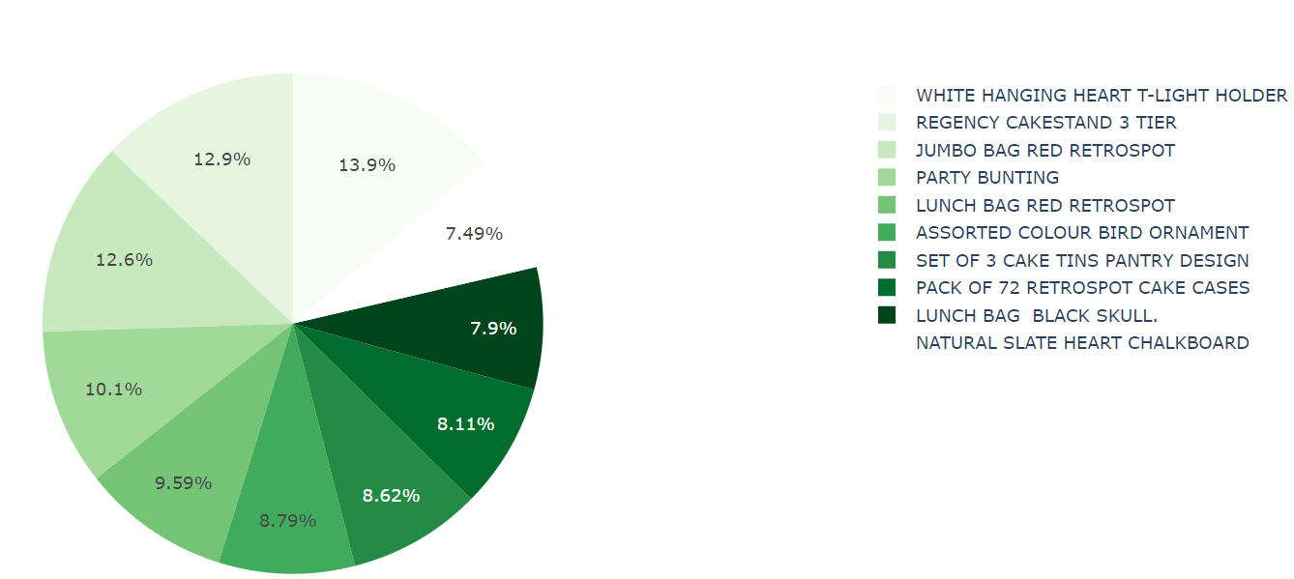
Most Bought Item
Page 07
A pie chart visually represents the distribution of items purchased from an online retail store. It is an effective tool for displaying the proportional contribution of each category to the overall purchases.
Among the ten items depicted in the pie chart, the white hanging heart T-light holder constitutes the highest proportion at 13.9%, with a count of 2369. In contrast, the natural slate heart chalkboard represents the lowest share at 7.49%, with a count of 1280.

Slide 8
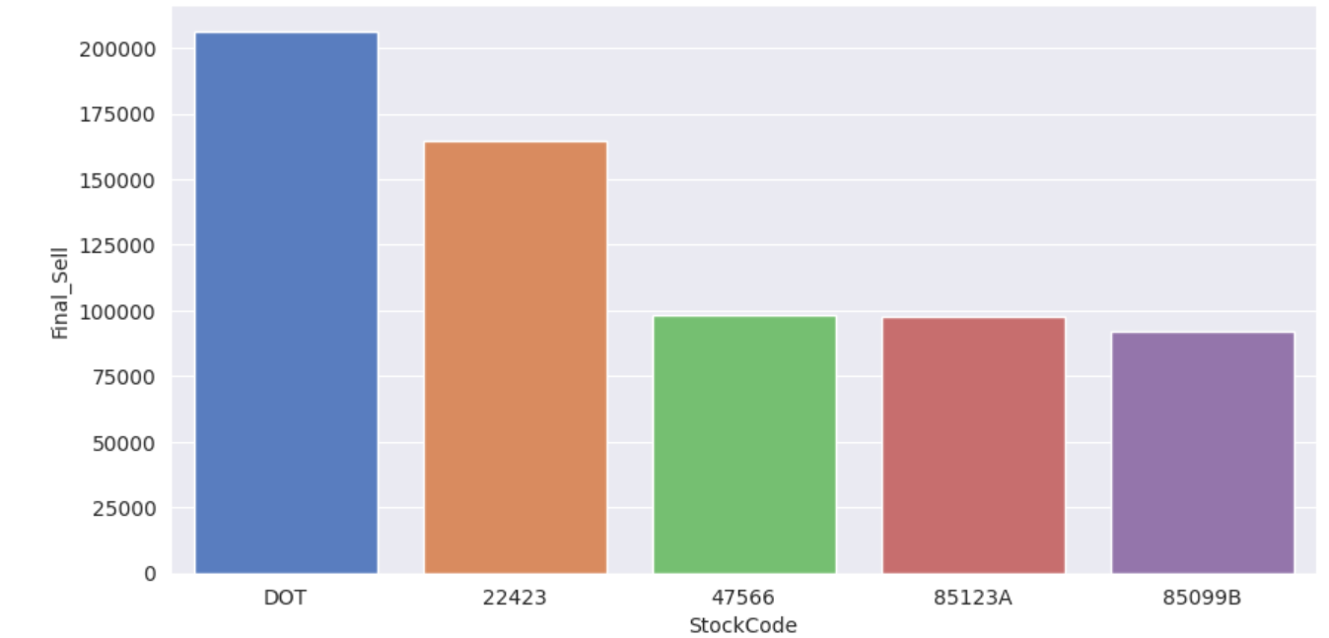
Stock Code VS Final sell
Page 08
A bar plot visually presents stock codes alongside their respective actual sales on an online retail store.
The bar plot highlights the top 5 highest-selling stock code products and their respective revenues on an online retail store. Topping the list is stock code "Dot" with the highest revenue of $206,245.48, followed by stock code 22423 generating $164,762.19. The next three top-selling products are identified by stock codes 47566, 85123A, and 85099B.

Slide 9
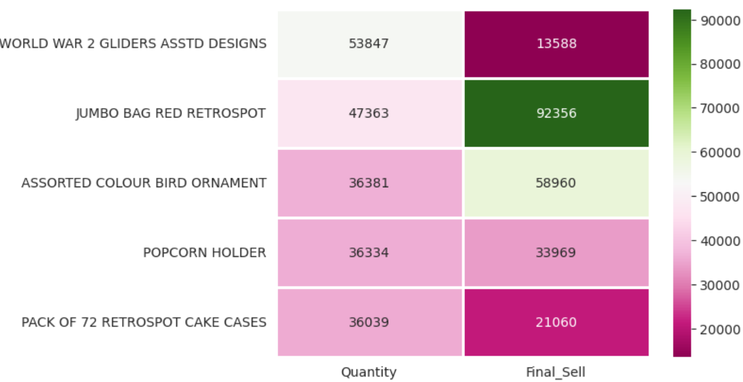
Quantity VS Final Sell
Page 09
The heatmap visually presents the top 5 most purchased items, detailing their respective quantities and final sales.
It reveals the top 5 most purchased items. The highest quantity, 53,847, and final sell of 13,588 are attributed to the "World War 2 Glider Assorted Designs." Following closely is the "Jumbo Bag Red Retrospot" with 47,363 units and a final sell of 92,356. Other notable entries include the "Assorted Colour Bird Ornament" (36,381 units, final sell 58,960), "Popcorn Holder" (36,334 units, final sell 33,969), and "Pack of 72 Retrospot Cake Cases" (36,039 units, final sell 21,060).

Slide 10
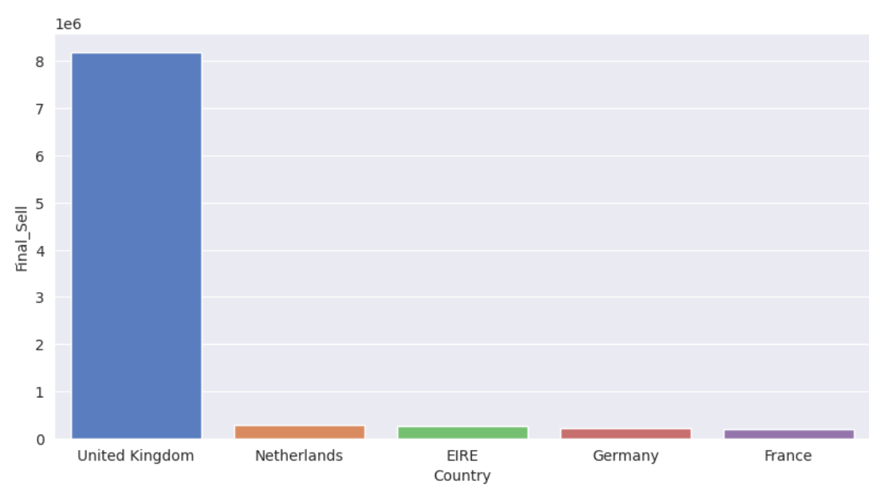
Country VS Final Sell
Page 10
The bar plot highlights the top 5 revenue earners in various countries, showcasing their respective final sales.
The plot indicates that the United Kingdom (UK) boasts the highest sales, exceeding 8, while the remaining four countries—Netherlands, EIRE, Germany, and France—show significantly lower sales, each falling below 1.

Slide 11
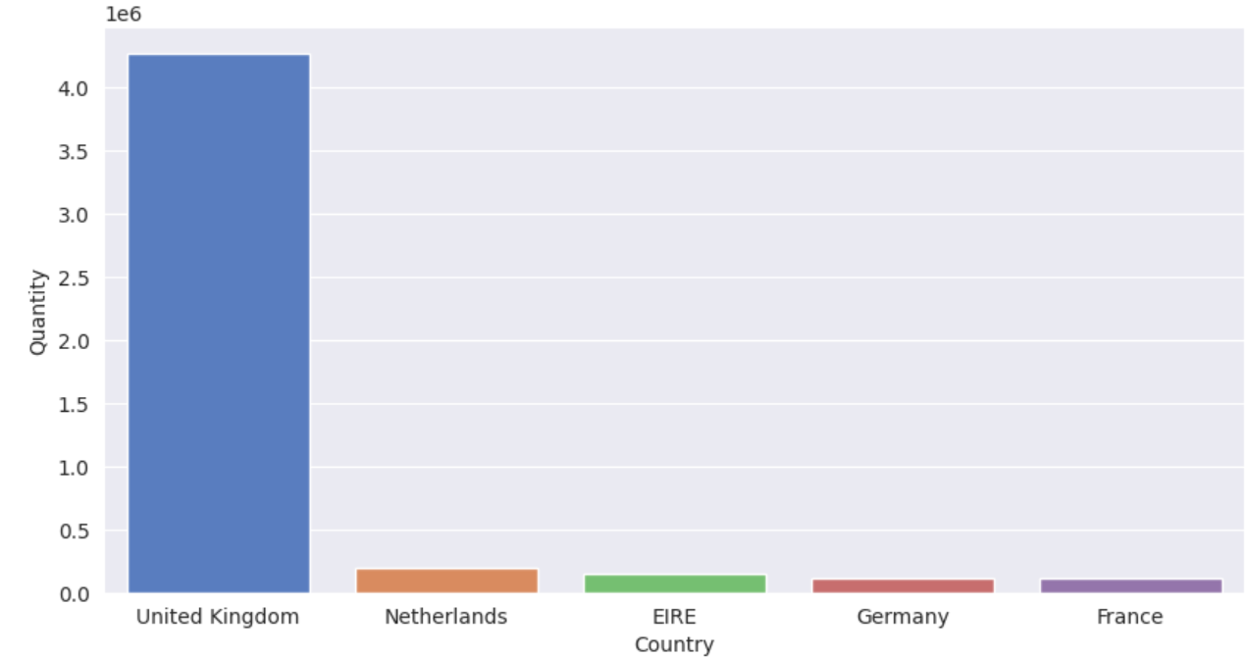
Country VS Quantity
Page 11
The bar plot illustrates the highest earnings in different countries along with their corresponding quantities.
The plot indicates that the United Kingdom (UK) leads in quantity with a value exceeding 4.0, while the other four countries—Netherlands, EIRE, Germany, and France—demonstrate significantly lower quantities, each falling below 0.5.

Slide 12
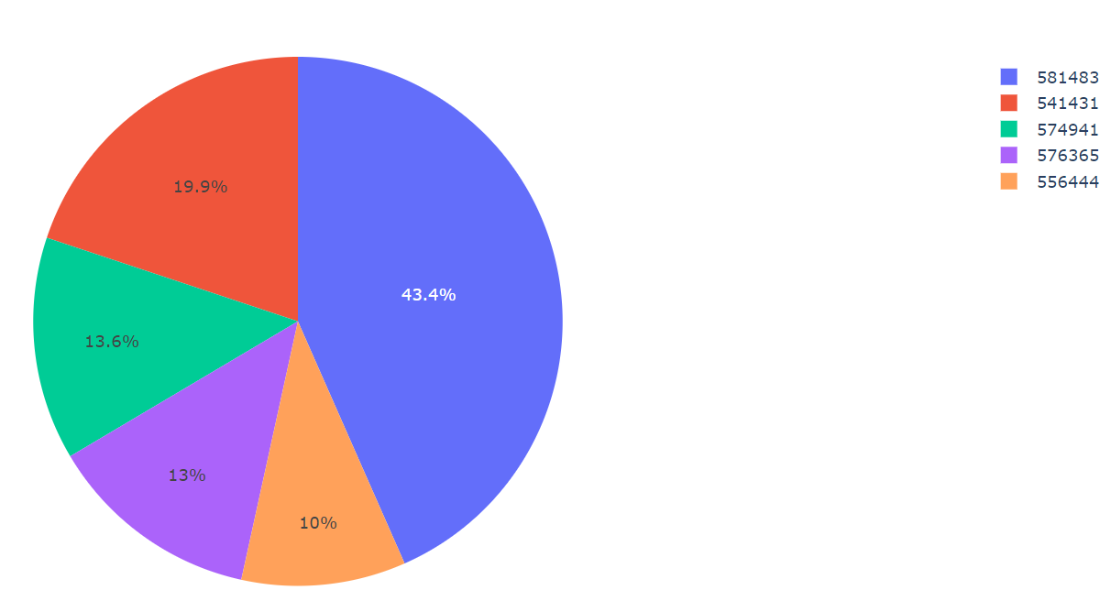
Invoice No. & Final sell
Page 12
The pie chart visually displays the top 5 invoice numbers alongside their respective final sales values.
The analysis reveals that the top invoice is 581483, contributing 43.4% to the total sales with a final value of 541,431. Following closely is invoice no. 541431, accounting for 19.9% and a final sale of 77,183.6. Subsequent top invoices include 574941 (13.6%, final sell: 52,940.94), 576365 (13%, final sell: 50,653.91), and 556444 (10%, final sell: 38,970).

Slide 13
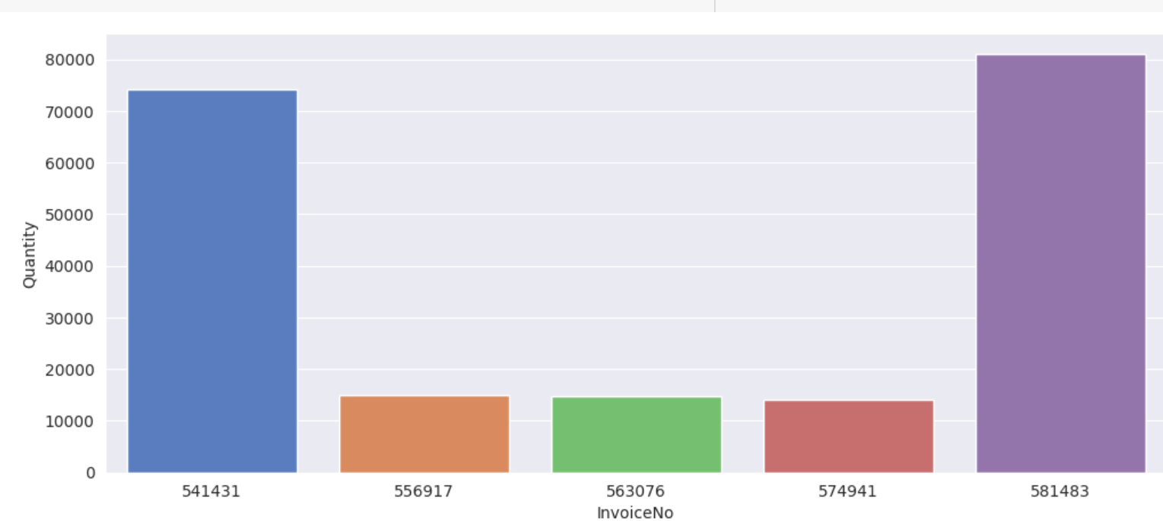
Invoice No. VS Final sell
Page 13
The bar plot visually highlights the top 5 invoices with the highest quantities. The graph reveals that invoice no. 581483 has the highest quantity, exceeding 80,000, followed by invoice no. 541431 with a quantity surpassing 70,000. Invoices 556917, 563076, and 574941 have quantities less than 20,000, with minimal differences among them. This insight is vital for recognizing major order contributors.

Slide 14
Page 14
Conclusion
The comprehensive analysis of various charts provides valuable insights for strategic decision-making in the online retail context. Recognizing top-selling items, understanding revenue distribution across countries, and identifying customer preferences enable the formulation of targeted marketing strategies and optimized inventory management. Insights from invoice analysis guide financial strategies. The observed sales trends and quantities highlight significant market variations, informing tailored approaches for different regions. This data-driven approach ensures the online store can effectively meet customer demands, streamline operations, and enhance overall business performance, fostering increased customer satisfaction and sustained growth in the dynamic landscape of online retail.

Slide 15
THANK
YOU!
BY, GHANSHYAM SINGH SHAKTAWAT

